Slide 1
Artificial Intelligence (Machine Learning & Deep Learning)
{
Measures of Dispersion & Position
}
...

Slide 2
{
..
"Talk is cheap. Show me the code." – Linus Torvalds
(Creator of Linux and Git)
}
..

Slide 3
Contents of Day 8
Data Types & Measures of Central Tendency
Recap & introduction | Moving from Python OOP to Data Science. Why AI needs data.
Core Thoery | Dispersion: Variance & Standard Deviation. //spread of values Coefficient of Variation (CV). Skewness & Kurtosis. Position: Quartiles & Percentiles. Z-Score
Lab Practice | Practical coding tasks implementing method
Advance Lab | Building the automated Govt Tax Auditing Pipeline.
Wrap-up & Q&A | Debugging tips along with Q&A and suggestion
Important: Use of AI for solving given task is not allowed. Cellphones must be put on silent.

Slide 4
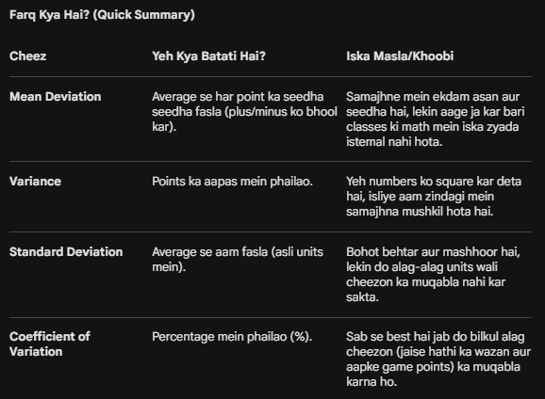
Core Concept (Definition & Rules) exmaple on next page
Measures of Dispersion (The Spread) - Variance & Standard Deviation
While Central Tendency tells you where the center of your data is,
Measures of dispersion (also called measures of variability(change) are statistical tools used to describe the spread or scatter of data points around the center, in a dataset.

Slide 5
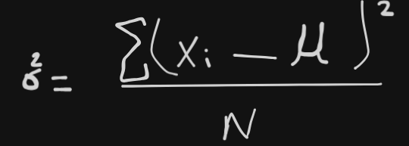
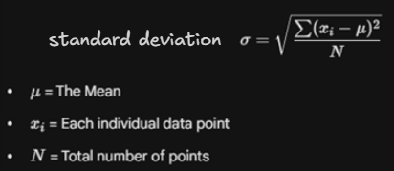


Common measures of dispersion are:
Common measures of dispersion are:
1. Range(gives gap btw max-min): highest value minus lowest value. Sensitive to extreme values. It does not consider the distribution. Suitable for small dataset.
2. Variance: measures how far each number in the set is from the mean. It tells you the "average of the squared differences”.
3. Standard Deviation: square root of variance. Average se aam fasla (asli units mein). +- both
4. Mean deviation: average of absolute deviations from the mean. Average se har point ka seedha seedha fasla (plus/minus ko bhool kar). X is each datapoint, u –is mean
5. Coefficient of Variation: It is the ratio of the Standard Deviation to the Mean, usually expressed as a percentage. It is used to compare the spread of two different datasets that have different units or very different means.
Percentile: devide data into 100 parts
Quartiles: devide data into 4 equal parts.
Quartile deviation: spread of the middle 50% (Q3-Q1) of the data.

Slide 6
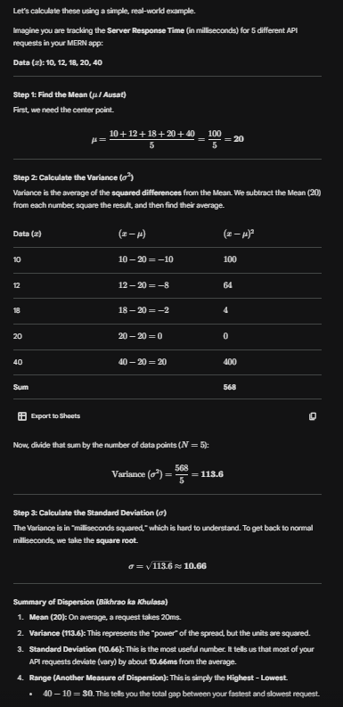

Slide 7
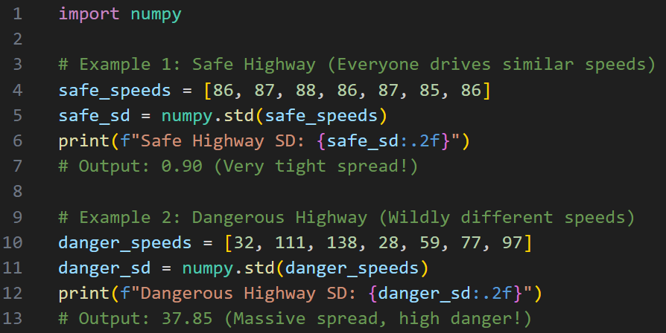
Core Concept (Definition & Rules)

Slide 8
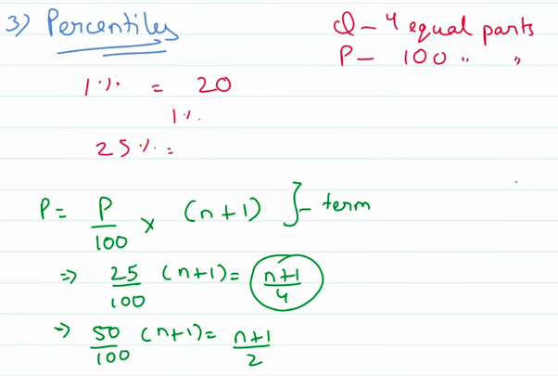
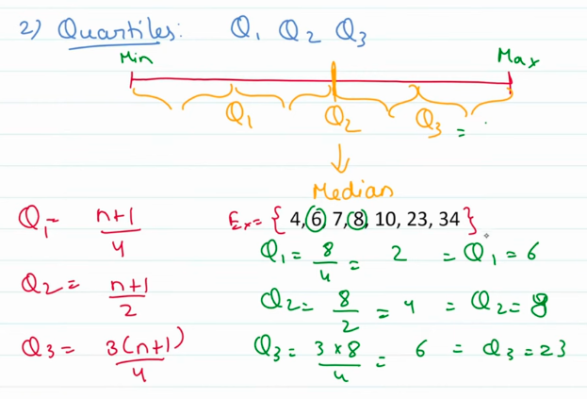
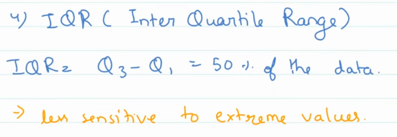
Core Concept (Definition & Rules)
Percentiles: A percentile tells you what percentage of the data falls below a certain value. It splits the data into 100 equal parts.
Example: If you score in the 90th percentile on an English test, it doesn't mean you got 90% marks. It means you performed better than 90% of the people who took the test.
Quartiles: A special type of percentile that strictly divides the data into four equal parts (Q1->25%, Q2->50%, Q3->75%). If Q3=30 means 30 lies in 75% data.
The Govt Analogy: The National Census is looking at the ages of people living on a specific street to plan for a new school. If you find the 75th percentile, you know that 75% of the people on that street are younger than that exact age.
Interquartile Range (IQR):This is a very important term in Data Science. The IQR is simply the distance between the 1st and 3rd quartiles: IQR = Q3 - Q1
Why use it? It represents the middle 50% of your data. Identifying Outliers: In AI and Data Analysis, if a data point is way outside the IQR (usually $1.5 \times IQR$ above Q3 or below Q1), we call it an Outlier (ajnabi value). It’s probably a mistake or a very rare case that we should investigate.
Percentiles & Quartiles

Slide 9
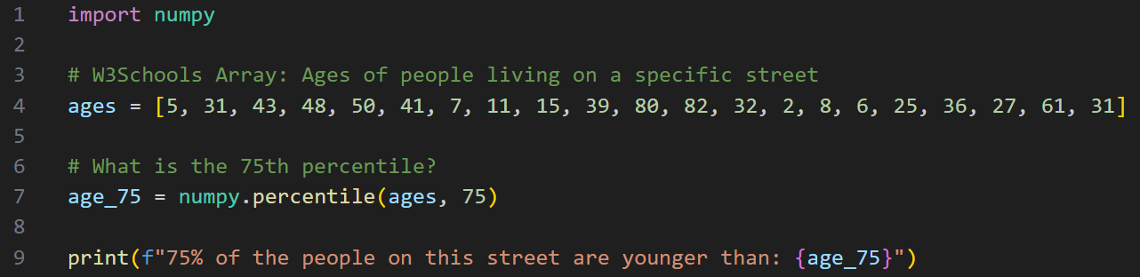
Core Concept (Definition & Rules)
Percentiles & Quartiles
In AI/Machine Learning, we use IQR to detect Outliers. If a data point is way outside the IQR range, we often delete it or fix it because it might be a mistake (khurafat) in the data.

Slide 10
Core Concept (Definition & Rules)
Coefficient of Variation, Skewness & Kurtosis
Coefficient of Variation (CV): It is a relative measure of dispersion. It is the ratio of the Standard Deviation to the Mean, usually expressed as a percentage. It is used to compare the spread of two datasets that have different units or very different means.
i.e Project B is actually more stable because its variation is only 10% of its income, while Project A's variation is 20%. So its less stable.
Skewness(Terha-pan / Jhukaon): Tells you if the data is lopsided(one side lower then other). Does the tail of the data drag to the left or the right?
Mean, Median, mode are equal at zero symmetric. Image on next slide.
Kurtosis(Choti ya Bhaari-pan): Tells you how "heavy" the tails are. Are there extreme, wild outliers lurking(remaining hidden) at the edges of your data?
The Govt Analogy: If the National Wealth data has High Kurtosis and Right Skewness, it means the middle class is shrinking and a few extreme billionaires are hoarding the wealth at the far-right edge of the graph.
Definition:

Slide 11
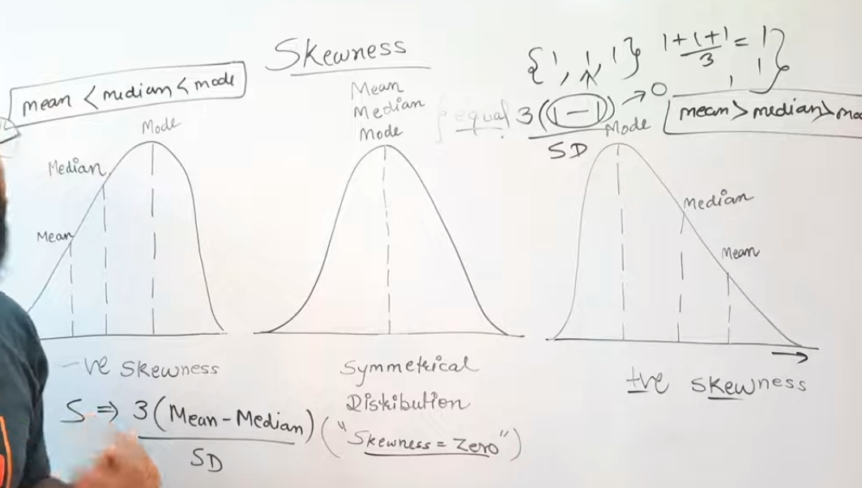
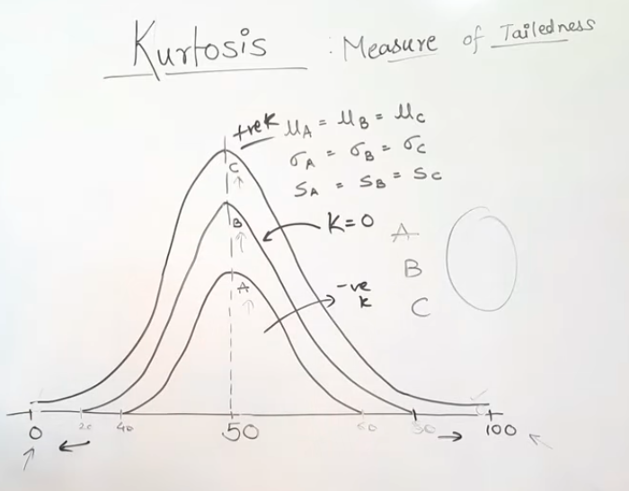

Slide 12
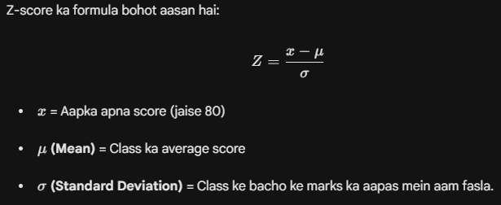
Core Concept (Definition & Rules)
Z-Score (Aapka score class ke average se kitna door hai)
Z-score ka jawab hamesha ek chota sa number aata hai (jaise 0, 1, 2, ya -1, -2):
Definition:
Z-Score: A numerical measurement that describes a value's relationship to the mean of a group of values, measured in Standard Deviations.
The Govt Analogy: The Tax Authority wants to catch fraudsters. A Z-Score of 0 means your tax return is perfectly average. A Z-Score of +3 means your income is suspiciously high compared to your neighbors. A Z-Score of -3 means you are claiming impossible poverty. Flag them for an audit!

Slide 13
Thank You for Your Focus Today!
What was the most confusing part of today's lab?
Waleed Khan (Robotics Engineer | Senior Python Developer)
Email: 0xcloudcoder@gmail.com Contact: +923126008702
}
*

